Slide 1
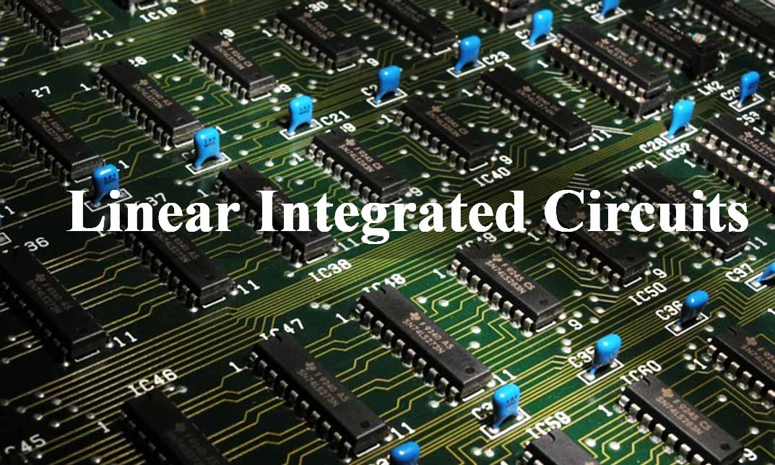
15EC502 – Linear Integrated Circuits

Slide 2
UNIT I - IC FABRICATION AND CIRCUIT CONFIGURATION FOR LINEAR ICS
Advantages of ICs over discrete components
Manufacturing process of monolithic ICs
bipolar transistor
diodes
Integrated Resistors
Capacitors
Inductors.
Differential gain – CMRR
General operational amplifier stages
Internal circuit diagrams of IC 741
DC and AC performance characteristics
Slew rate
Open and closed loop configurations

Slide 3
Advantages of ICs over discrete components
Miniaturization and hence increased equipment density
Cost reduction due to batch processing
Increased system reliability due to elimination of soldered joints
Improved functional performance.
Matched devices.
Increased operating speeds.
Reduction in power consumption.
packaged ICs use much less material than discrete circuits
Uniformity of components
Ease of manufacture
Speed, Size, Cost, Power Consumption improvement
More robust against vibration

Slide 4
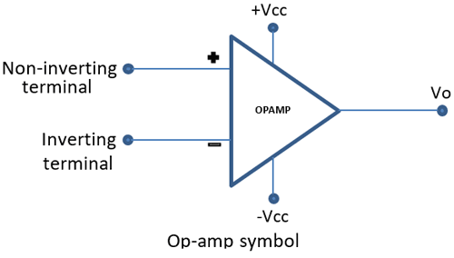
Basic Information of Op-Amp
Op-Amp Symbol

Slide 5
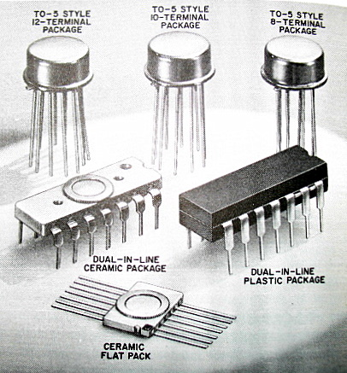
Basic Information of Op-Amp
Packages
The Metal Can (TO) Package
The Dual-in-line Package
The Flat package or Flat pack

Slide 6
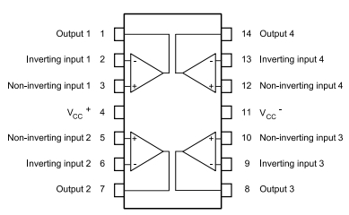
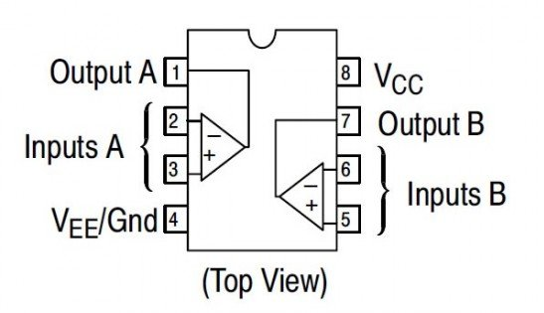
Basic Information of Op-Amp
Package may contain Single, Two (Dual) or Four (Quad) Op-Amps
Number of pins (8 – CAN, DIP; 10 - Flat; 14 – IP)

Slide 7
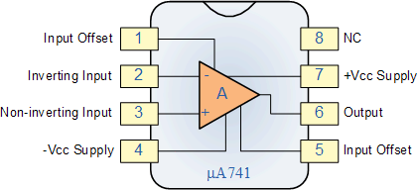
Basic Information of Op-Amp
Op-Amp Terminals

Slide 8
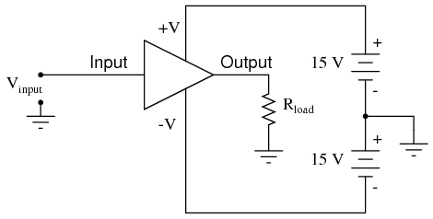
Basic Information of Op-Amp
Op-Amp Power Supply Connections
Gnd is Must, otherwise twice the supply damage the Op-Amp.

Slide 9
Basic Information of Op-Amp
Op-Amp Power Supply Connections
Instead of single power supply,
Use resistive divider
Use Zener Diodes
Use of Potentiometer and Diodes.

Slide 10
Basic Information of Op-Amp
Op-Amp Manufacturers
Fairchild - µA, µAF
National Semiconductor - LM, LH, LF, TBA
Motorola - MC, MFC
RCA - CA, CD
Texas Instruments - SN
Signetics - N/S, NE/SE
Burr/Brown - BB
Op-Amp Numbers will end up with 741 (Ex.: LM 741)

Slide 11
Basic Information of Op-Amp
Op-Amp Manufactured for….
741 - Military Purpose (Temp. -55°C - 125°C)
741C - Commercial (Temp. 0°C - 75°C)
741A - Improved version of 741
741E - Improved version of 741C
741S - Military with High Slew-Rate
741SC - Commercial with High Slew-Rate
Electrical Properties

Slide 12
Fabrication Process
I. Basic Planar Fabrication Process
Silicon Wafer Preparation
Epitaxial Growth
Oxidation
Photolithography
Diffusion
Ion Implantation
Isolation Techniques
Metallization
Assembling and Packaging
II. Fabrication Process of a Circuit
III. Fabrication Process of Active and Passive Elements
Transistors (BJT and FET)
Diode
Resistors
Capacitors
Inductors

Slide 13
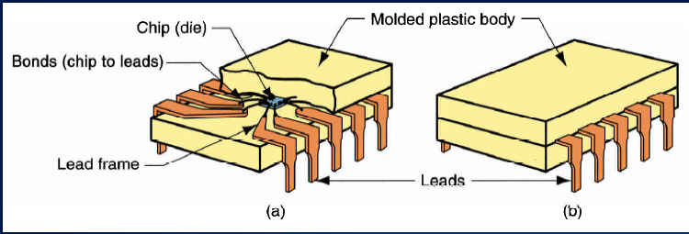
Fabrication Process

Slide 14
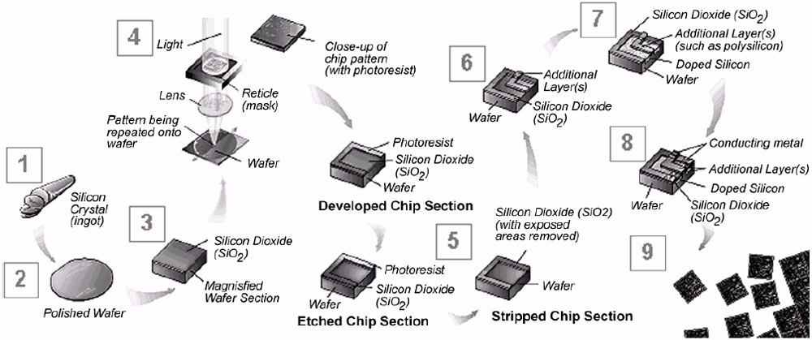
Fabrication Process

Slide 15
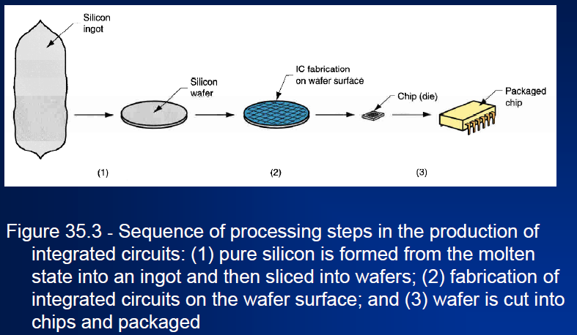
Fabrication Process
Basic Planar Fabrication Process :
Silicon Wafer Preparation

Slide 16
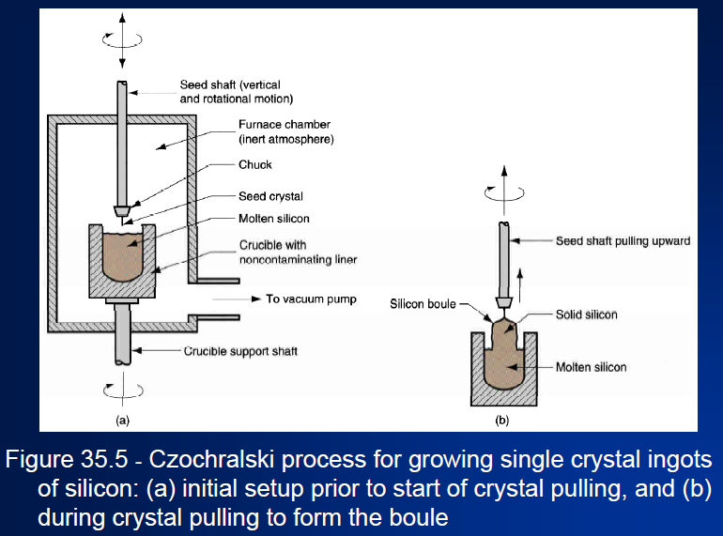
Fabrication Process
Basic Planar Fabrication Process :
Silicon Wafer Preparation

Slide 17
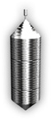
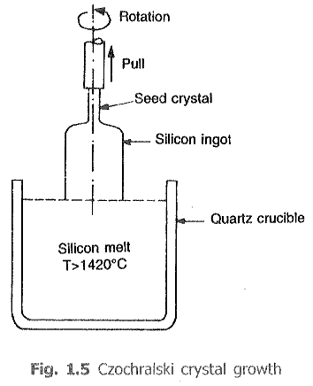

Fabrication Process
Basic Planar Fabrication Process :
Silicon Wafer Preparation

Slide 18
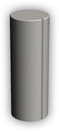
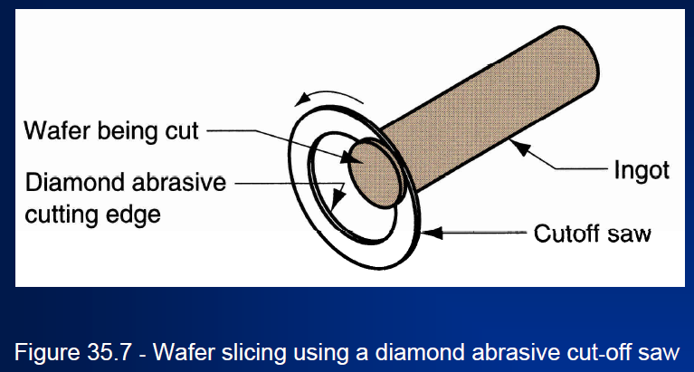
Fabrication Process
Basic Planar Fabrication Process :
Silicon Wafer Preparation

Slide 19
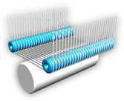
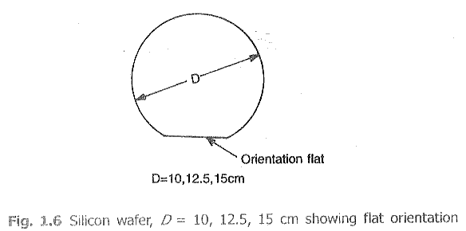
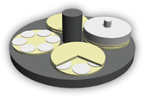
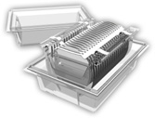
Fabrication Process
Basic Planar Fabrication Process :
Silicon Wafer Preparation

Slide 20
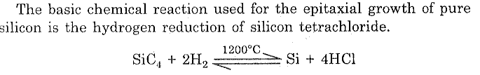
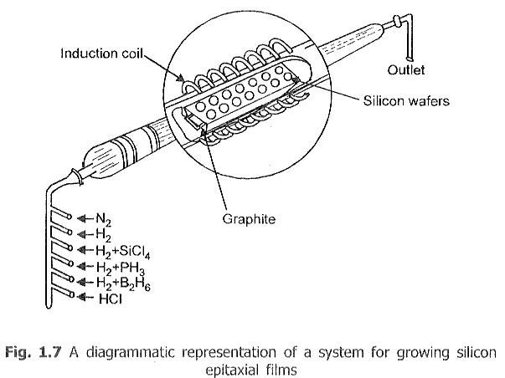
Fabrication Process
Basic Planar Fabrication Process :
Epitaxial Growth

Slide 21
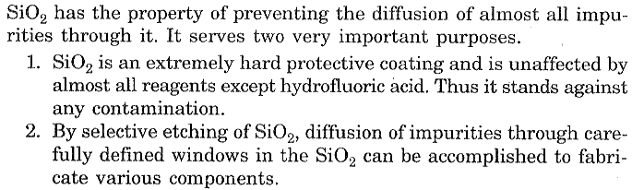
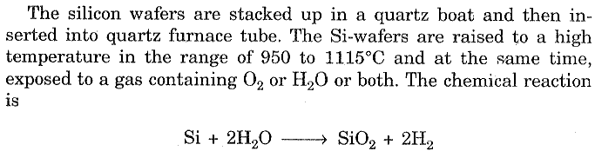
Fabrication Process
Basic Planar Fabrication Process :
Oxidation

Slide 22
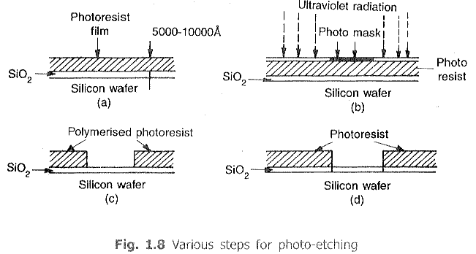
Fabrication Process
Basic Planar Fabrication Process :
Photolithography

Slide 23
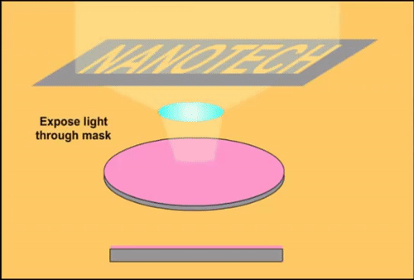
Fabrication Process
Basic Planar Fabrication Process :
Photolithography

Slide 24
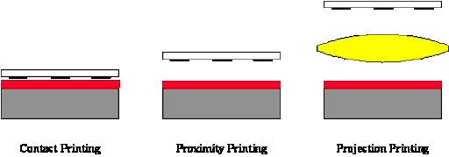
Fabrication Process
Basic Planar Fabrication Process :
Photolithography

Slide 25
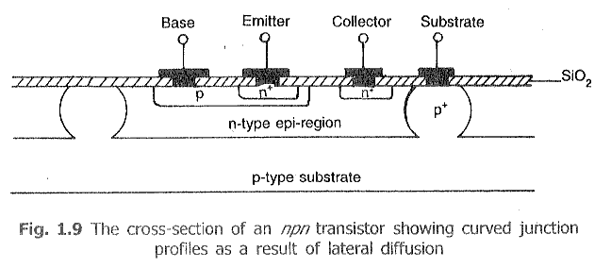
Fabrication Process
Basic Planar Fabrication Process :
Diffusion Process

Slide 26
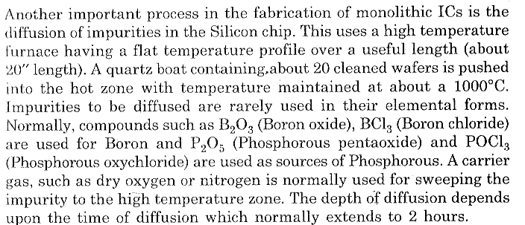
Fabrication Process
Basic Planar Fabrication Process :
Diffusion Process

Slide 27
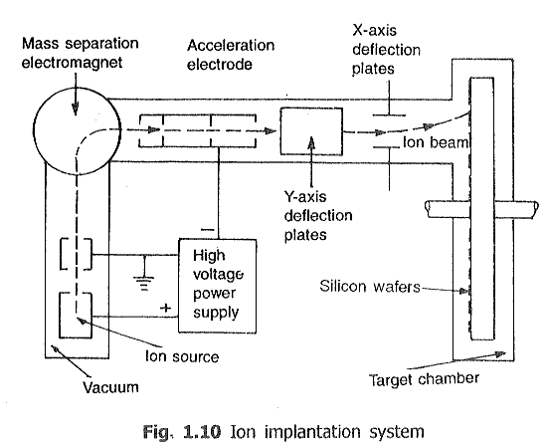
Fabrication Process
Basic Planar Fabrication Process :
Ion Implantation

Slide 28
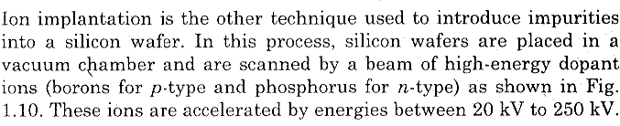
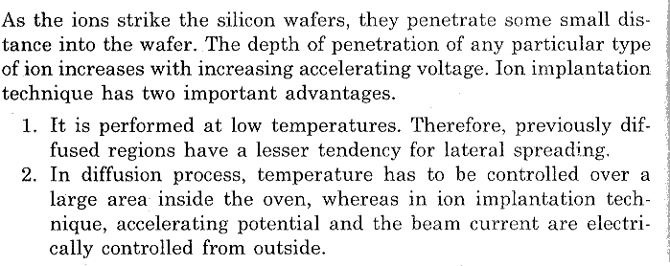
Fabrication Process
Basic Planar Fabrication Process :
Ion Implantation

Slide 29
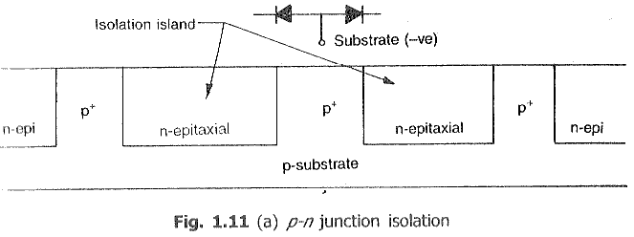
Fabrication Process
Basic Planar Fabrication Process :
Isolation Technique – PN Junction Isolation

Slide 30
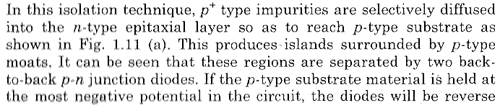
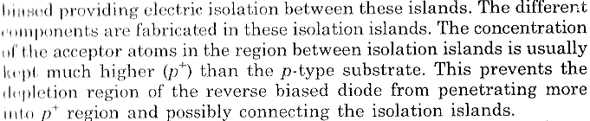
Fabrication Process
Basic Planar Fabrication Process :
Isolation Technique – PN Junction Isolation

Slide 31
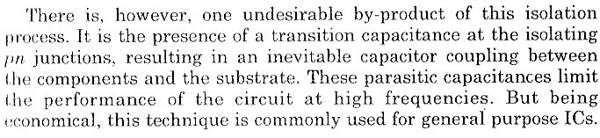
Fabrication Process
Basic Planar Fabrication Process :
Isolation Technique – PN Junction Isolation

Slide 32
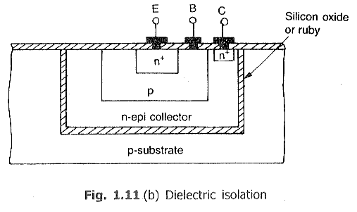
Fabrication Process
Basic Planar Fabrication Process :
Isolation Technique – Dielectric Isolation

Slide 33
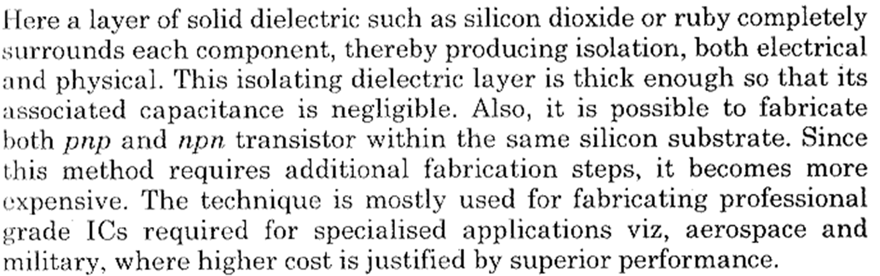
Fabrication Process
Basic Planar Fabrication Process :
Isolation Technique – Dielectric Isolation

Slide 34
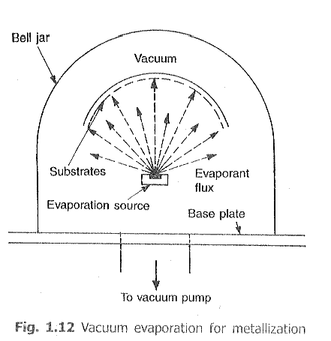
Fabrication Process
Basic Planar Fabrication Process :
Metallization

Slide 35
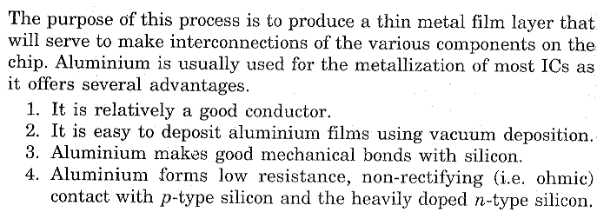
Fabrication Process
Basic Planar Fabrication Process :
Metallization

Slide 36
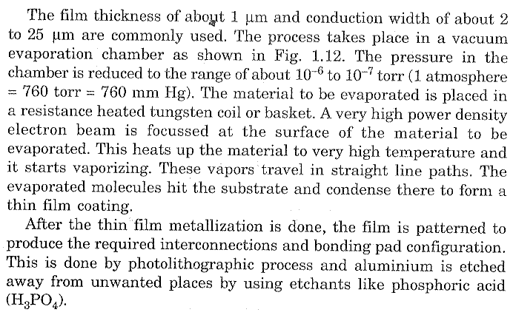
Fabrication Process
Basic Planar Fabrication Process :
Metallization

Slide 37
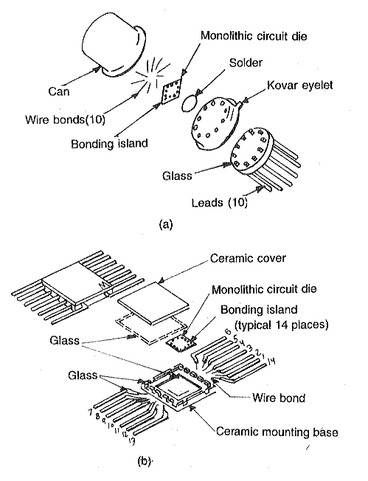
Fabrication Process
Basic Planar Fabrication Process :
Assembling and Packaging

Slide 38
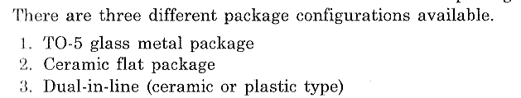
Fabrication Process
Basic Planar Fabrication Process :
Assembling and Packaging

Slide 39
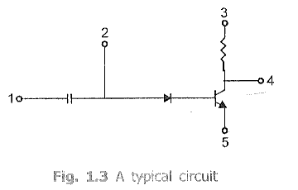
Fabrication Process
Fabrication Process of a Circuit:

Slide 40
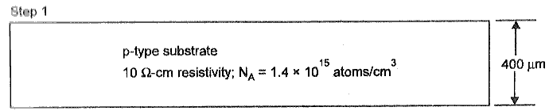
Fabrication Process
Fabrication Process of a Circuit:
Wafer Preparation

Slide 41
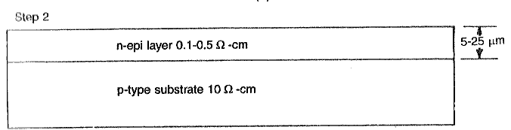
Fabrication Process
Fabrication Process of a Circuit:
Epitaxial Growth

Slide 42
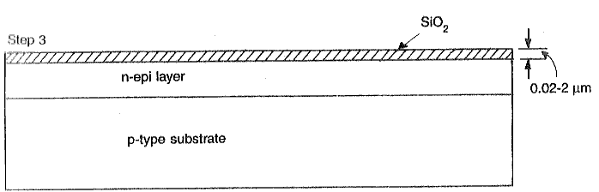
Fabrication Process
Fabrication Process of a Circuit:
Oxidation

Slide 43
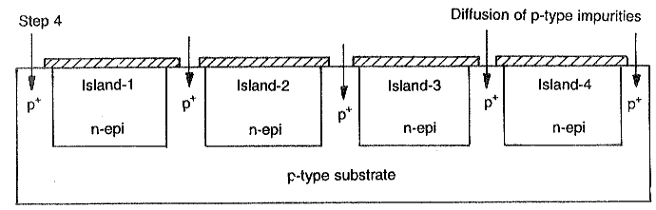
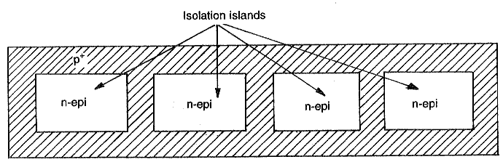
Fabrication Process
Fabrication Process of a Circuit:
Isolation Diffusion
Isolation Diffusion – Top View

Slide 44
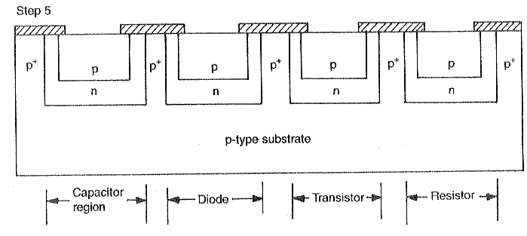
Fabrication Process
Fabrication Process of a Circuit:
Base Diffusion

Slide 45
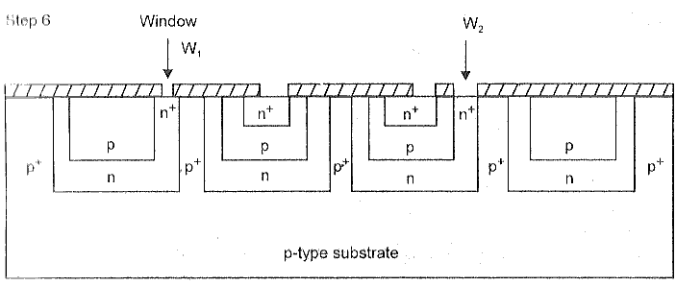
Fabrication Process
Fabrication Process of a Circuit:
Emitter Diffusion

Slide 46

Fabrication Process
Fabrication Process of a Circuit:
Emitter Diffusion – Top View

Slide 47

Fabrication Process
Fabrication Process of a Circuit:
Aluminium Metallization

Slide 48

Fabrication Process
Fabrication Process of a Circuit:
Aluminium Metallization

Slide 49

Fabrication Process
Fabrication Process of a Circuit:
Cross-sectional View

Slide 50

Fabrication Process
Fabrication Process of a Circuit:
Cross-sectional View

Slide 51
INTEGRATED CAPACITORS AND INDUCTORS

Slide 52
INTEGRATED CAPACITORS
METHODS:
>Junction Capacitor
>MOS and Thin film Capacitor

Slide 53

1] JUNCTION CAPACITOR

Slide 54
Description
> 2 Junctions J1,J2
> J2 –reverse biased : produces C2(desired capacitance)
> J1-present between n-type layer and substrate : produces C1
>Due to bulk resistance of n-type region there occurs a series resistance R

Slide 55
Conditions
> To minimize C1,substrate must be held at the most negative point in the circuit.
>Value of C2 depends on:
* Area of the junction
* Impurity concentration of n-type layer.
* Voltage across the junction

Slide 56
Inference
> C2 is polarized -It can be obtained only when
the junction is reverse biased..
> Therefore, the junction capacitance of a reverse biased diode is used as an element in
monolithic ICs..

Slide 57


2]MOS AND THIN FILM CAPACITOR

Slide 58
MOS
>Parallel plate capacitor
>SiO2 – dielectric
>n-type region : lower plate
>thin film of aluminium
metallization : upper plate
>It consists of a resistance R due to n+ region ,junction J1 and associated capacitance C1

Slide 59
Inference
>capacitor is non-polar:
The plates can be positive or negative
and it is not a function of voltage applied.
>Silicon Nitride(Si3N4)-can be use as a dielectric layer to give more circuit flexibility.

Slide 60
THIN FILM CAPACITOR
>Aluminium or tantalum is used as capacitor plates.
>aluminium oxide(Al2O3) or tantalum oxide(Ta2O5) is used as dielectric plates.
>cons:
it fails when voltage rating exceeds due to breakdown of the dielectric.
It is a destructive and irreversible failure mechanism and hence requires voltage protection.

Slide 61
Comparison
Junction capacitor
Mos capacitor
>The desired capacitance (C2) is polarised.
>It can only be obtained when the junction (J2) is reverse biased.
>It depends upon the applied voltage.
>The capacitor is non-polar.
>the plates can be either positive or negative
>It is not a function of the voltage applied.

Slide 62
INTEGRATED INDUCTORS
IC inductors can be made into a metallic thin film spirals-by successive deposition of conduction patterns.
Inductance in the order of nano-henry with low quality can only be obtained.
A 3-dimensional coil structure is required to obtain large no.of turns.

Slide 63
Applications
In RF circuits , inductors external to IC-packages are used.
In thin film MIC , thin- film inductor spirals are used giving upto 250 nH.

Slide 64
MONOLITHIC DIODES AND SCHOTTKY BARRIER DIODE

Slide 65

VARIOUS DIODE STRUCTURE:

Slide 66

TYPICAL VALUES:

Slide 67
DEFINITION:
Breakdown voltage: It is the maximum voltage that the diode can withstand in reverse bias condition
Storage time: The time period for the diode to remain in the conduction state even in the reverse bias state
Forward Voltage: Voltage drop across the diode in forward bias condition

Slide 68

Cross section of a monolithic diode:

Slide 69
OHMIC CONTACT RECTIFYING CONTACT
Diffuse n+ regions over the Al is deposited
Bipolar
Obeys ohms law
Al is directly deposited upon the n type
Unipolar
Forward voltage is 0.3v

Slide 70

VI CHARACTERISTICS:

Slide 71

SCHOTTKY DIODE:

Slide 72

FEATURES OF SCHOTTKY DIODE:
Hot Carrier Diode
Metal and semiconductor junctions
Electrons as a majority carrier
No depletion region is formed
Reverse Recovery time is less
Low Forward voltage drop (0.3v)
Used in low power applications
Used in high switching applications like microwave Ics,detectors,clampers.

Slide 73

Ideal Op-Amp Characteristics
V_{d} = 0

Slide 74
Ideal Op-Amp Characteristics
Characteristic | Value
Open Loop Gain (A_{OL}) | ∝
Input Resistance (R_{i}) | ∝
Output Resistance (R_{o}) | 0
Bandwidth of Operation (BW) | ∝
Offset Voltage (V₀= 0; when V₁=V₂= 0) | 0

Slide 75

Ideal Op-Amp Equivalent Circuit

Slide 76

Op-Amp Open Loop

Slide 77
Op-Amp Closed Loop
Assumptions
Current drawn by either of the input terminals is negligible.
The differential input voltage V_{d} is essentially Zero.
The Output Voltage (V₀) is independent of current drawn from output (as R₀ = 0).
V₀ = A_{OL}.V_{d} = A_{OL}. (V₁-V₂)

Slide 78
Op-Amp Closed Loop
Configurations
Inverting Amplifier
Non-Inverting Amplifier
Voltage Follower
Differential Amplifier

Slide 79

Op-Amp Closed Loop
Inverting Amplifier
No Current Flows into the Input Terminals
The Differential Input Voltage is Zero as V₁ = V₂ = 0 (Virtual Ground)

Slide 80



Op-Amp Closed Loop
Inverting Amplifier
Closed-Loop Voltage Gain is,

Slide 81
Problem
Design an Amplifier with a gain of -10 and input resistance equal to 10kΩ..
Solution:
Given
Gain = -10
R_{i} = 10kΩ

Slide 82
Problem
Design an Amplifier with a gain of -10 and input resistance equal to 10kΩ.
Solution:
Given
Gain = -10
R_{i} = 10kΩ
R_{f} = -A_{CL} R_{i} = - (10)×(10kΩ) = 100kΩ

Slide 83

Problem
In an Inverting Amplifier, R₁= 10kΩ , Rf= 100kΩ, Vi=1V. A load of 25kΩ is connected to the output terminal. Calculate,
i₁, V₀, i_{L}, and Total Current i₀?
Solution:
Given
R₁= 10kΩ ,
Rf= 100kΩ,
Vi=1V,
A load of 25kΩ

Slide 84

Problem

Slide 85

Op-Amp Closed Loop
Non-Inverting Amplifier
No Current Flows into the Input Terminals
The V_{d} Differential Input Voltage is Zero. Hence, Potential at V₁ = V_{i}

Slide 86

Op-Amp Closed Loop
Non - Inverting Amplifier
Closed-Loop Voltage Gain is,

Slide 87
Problem
Design an Amplifier with a gain of +5 using an Op-Amp.
Solution:
Given
Gain = +5

Slide 88
Problem
Design an Amplifier with a gain of +5 using an Op-Amp.
Solution:
Given
Gain = +5
Assume, R₁ = 10kΩ
A_{CL} = (1+ (R_{f}/R₁)) => 5 = 1+ (R_{f}/R₁) =>
R_{f} = 40kΩ

Slide 89

Problem
In an Non-Inverting Amplifier, R₁= 5kΩ , R_{f}= 20kΩ, Vi=1V. A load of 5kΩ is connected to the output terminal. Calculate,
V₀, A_{CL}, i_{L}, Total Current i₀ and direction of flow?
Solution:
Given
R₁= 5kΩ ,
Rf= 20kΩ,
Vi=1V,
A load of 5kΩ

Slide 90
Problem
Solution:
V₀=V_{i}(1+ (R_{f}/R₁)) = 5V
A_{CL} = V₀/V_{i} = 5
i_{L} = V₀ / R_{L} = 1mA
i₁ = V_{i}/R₁ = V₀-V_{i} = 0.2mA
i₀ = i_{L} + i₁ = 1.2mA

Slide 91

Op-Amp Closed Loop
Voltage Follower
R_{f}=0; R_{i}=Infinity; V_{o}=V_{i}; R₀=0
Used for Impedance Matching Circuitry.

Slide 92
Op-Amp Closed Loop
Voltage Follower
Advantages of Voltage Follower
Provides power gain and current gain.
Low output impedance to the circuit which uses the output of the voltage follower.
The Op-amp takes zero current from the input.
Loading effects can be avoided.
Applications of Voltage Follower
Buffers for logic circuits.
In Sample and hold circuits.
In Active filters.
In Bridge circuits via transducer.

Slide 93

Op-Amp Closed Loop
Differential Amplifier

Slide 94
Op-Amp Closed Loop
Analysis
Assume, it is ideal Op-Amp,
Current in to the Op-Amp is Zero.
V_{d}=0; then, V_{a}=V_{b}.
At Node ‘a’,
(V_{a} – V₁)/R₁ + (V_{a} – V₀)/R₃ = 0 ----- (1)
At Node ‘b’,
(V_{b} – V₂)/R₂ + (V_{b} – 0)/R₄ = 0 ----- (2)
In equation (2), put R₁=R₂ and R₃ = R₄, and Rearranging,
(1) => V_{a} (1/R₁ – 1/R₃) – (V₁/R₁) = V₀/R₃ ----- (3)
=> V_{a} (1/R₁ – 1/R₃) – (V₂/R₁) = 0 (ஃ V_{a} = V_{b}) ----- (4)
Subtract (3) – (4),
-(V₁/R₁) + (V₂/R₁) = V₀/R₃ ----- (5)
Rearranging the above,
V₀ = R₃/R₁ (V₂-V₁)

Slide 95

Op-Amp Closed Loop
Differential Amplifier
Consider V₁=V₂=V₃ Find A_{CL}?
R1 = R2 = R3 = R4 then the circuit will become a Unity Gain Differential Amplifier

Slide 96
Difference Mode and Common Mode Gain
If V₁ = V₂ => V₀ = ‘0’ (ஃ both inputs are cancelled and no output - Ideal)
But, Practically V₀ is not Zero for Common Mode.
Case i: V₁=100µV & V₂=50µV; then V₀= V₃.
Case ii: V₁=1000µV & V₂=950µV; then V₀= V₄.
V₃ is not equal to V₄; even V₁-V₂ is same both cases.
Hence, output voltage is dependent on V_{d} and V_{CM}.
V_{CM} = (V₁+V₂) / 2
Reason: Components Mismatch

Slide 97
Difference Mode and Common Mode Gain
Hence, Output Voltage is,
V₀ = A₁V₁ + A₂V₂ ----(1)
Where, A₁ = Gain of Input 1, when input 2 is Grounded.
A₂ = Gain of Input 2, when input 1 is Grounded.
Differential mode component : V_{d} = (V₁-V₂) Common mode component : V_{cm} = (V₁+V₂)/2
V_{cm} = (V₁+V₂)/2 ----(2) & 2V_{cm} = V₁ + V₂ ---- (3)
Since V_{d} = V₁ - V₂ ---- (4)
Therefore
(3) + (4) & V₁ = V_{cm} + V_{d}/2 ---- (5)
and (3) - (4) & V₂ = V_{cm} - V_{d}/2 ---- (6)

Slide 98
Difference Mode and Common Mode Gain
Sub. (5), (6) in eqn. (1), we get,
V₀ = A_{DM} V_{d} + A_{CM} V_{CM}.
Where,
Difference Mode Gain A_{DM} = (1/2)(A₁ – A₂)
Common Mode Gain A_{CM} = A₁+A₂
Hence, Common-Mode Rejection Ratio (CMRR) is,
CMRR (ρ) = | A_{DM} / A_{CM} |

Slide 99

Common Mode Rejection Ratio
CMMR = Differential mode gain / Common-mode gain
CMRR used to be in the range of 80 to 100 dB
Hence, Common-Mode Rejection Ratio (CMRR) is,
CMRR (ρ) = | A_{DM} / A_{CM} |
Ideally, ADM is Large and ACM is Zero; So that, CMRR = HIGH (for Good Op-Amp).
Ref.:: https://www.youtube.com/watch?v=hpCu3HbAiWg

Slide 100

DC Characteristics of Op-Amp
Ideal Op-Amp draws no current from the source and independent of Temperature.
Practically, current is taken from the source into the Op-Amp inputs.
Two inputs respond differently to Current and Voltage due to Mismatch.
Real Op-Amp has dependent on temperature.
Non-Ideal Characteristics are,
Input Bias Current.
Input Offset Current
Input Offset Voltage
Thermal Drift

Slide 101

1. Input Bias Current
The Differential amplifier may be FET or BJT based device.
In Ideal op-amp, we assume no current is drawn by the inputs.
In Practical due to mismatch of components current drawn in both the terminals.
They are named as I_{B}⁺ and I_{B}⁻
I_{B} = (I_{B}⁺ and I_{B}⁻ ) / 2

Slide 102
1. Input Bias Current
For BJT this I_{B} is 500nA and for FET I_{B} is 50pA
Ex.: if I_{B} = 500nA, V_{i} = 0, then V₀ is,
V₀ = (I_{B}⁻ R_{f})
if R_{f} = 100MΩ then,
V₀ = 500mV
The output is driven to 500mV with zero input, because of the bias currents.

Slide 103

1. Input Bias Current (with R_{comp})

Slide 104
1. Input Bias Current (with R_{comp})
Analysis
Current I_{B}⁺ flowing through the compensating resistor R_{comp}, then by KVL,
-V₁+0+V₂-V_{o} = 0 (or) ——>(1)
V_{o} = V₂ – V₁ ——>(2)
By selecting proper value of R_{comp}, V₂ can be cancelled with V₁ and the V_{o} = 0. The value of R_{comp} is derived
V₁ =I_{B}⁺R_{comp} ——>(3)
I_{B}⁺ = V₁/R_{comp} ——>(4)

Slide 105
1. Input Bias Current (with R_{comp})
The node ‘a‘ is at voltage (-V₁). Because the voltage at the non-inverting input terminal is (-V₁). So with Vi = 0
I₁ = V₁/R₁ ——>(5)
I₂ = V₂/R_{f} ——>(6)
For compensation, Vo should equal to zero (V_{o} = 0, V_{i} = 0). i.e. from equation (2) V₂ = V₁. So that from (6)
I₂ = V₁/R_{f} ——>(7)
KCL at node ‘a‘ gives,
I_{B}⁻= I₂ + I₁ add eqn, (5) and (7), we get,
I_{B}⁻= V₁ ((R₁ + R_{f})/R_{f}R₁) ——>(8)
Assume I_{B}⁻ = I_{B}⁺ then from (4) & (8),
R_{comp} = ((R₁ + R_{f})/R_{f}R₁) = R₁ || R_{f}

Slide 106

1. Input Bias Current (with R_{comp})
Analysis
R_{comp} = ((R₁ + R_{f})/R_{f}R₁) = R₁ || R_{f}
Ref.: http://www.brainkart.com/article/DC-Characteristics-of-op-amp_13376/

Slide 107
2. Input Offset Current
Bias current compensation will work if both bias currents I_{B}⁺ and I_{B}⁻ are equal.
Since the input transistor cannot be made identical. There will always be some small difference between I_{B}⁺ and I_{B}⁻. This difference is called the offset current.
|I_{os}| = I_{B}⁺ -I_{B}⁻
——>(1)
Offset current I_{os} for BJT op-amp is 200nA and for FET op-amp is 10pA. Even with bias current compensation, offset current will produce an output voltage when V_{i} = 0.

Slide 108
2. Input Offset Current
V₁ =I_{B}⁺R_{comp} ——>(2)
I₁ = V₁/R₁ ——>(3)
KCL at node ‘a‘ gives,
I_{B}⁻= I₂ + I₁
——>(4)
I₂ = (I_{B}⁻ - I₁ )
——>(5)
In (5), use (2) and (3) we get,
I₂ = (I_{B}⁻ - (I_{B}⁺R_{comp} /R₁)) ——>(6)

Slide 109

2. Input Offset Current
V_{o} = V₂ – V₁ ——>(7)
V_{o} = I₂ R_{f} – V₁ = I₂ R_{f} – I_{B}⁺R_{comp} ——>(8)
Sub. (6) in (8) and simplifying we get,
V_{o} = R_{f} (I_{B}⁻ – I_{B}⁺) ——>(9)
V_{o} = R_{f} (I_{os})

Slide 110

2. Input Offset Current
The offset current can be minimized by keeping feedback resistance small.
Unfortunately to obtain high input impedance, R₁ must be kept large. R₁ large, the feedback resistor R_{f} must also be high. So as to obtain reasonable gain.
Use T- Network in the feedback is a better solution.

Slide 111

3. Input Offset Voltage
Inspite of the use of the above compensating techniques, it is found that the output voltage may still not be zero with zero input voltage [V_{o} ≠ 0 with V_{i} = 0].

Slide 112

3. Input Offset Voltage
At node V₂ apply nodal equation and find V₀?
V₀ = V₂ (1+(R_{f} /R₁))
——>(1)
V_{ios} = |V_{i} -V₂| and V_{i} = 0.
——>(2)
V₀ = V_{ios} (1+(R_{f} /R₁))
From (1) and (2) =>

Slide 113
4. Total Output Offset Voltage
The total output offset voltage V_{OT} could be either more or less than the offset voltage produced at the output due to input bias current (I_{B}) or input offset voltage alone(V_{os}).
This is because I_{B} and V_{os} could be either positive or negative with respect to ground.
V_{OT} = V_{ios} (1+(R_{f} /R₁)) + R_{f} (I_{os})

Slide 114
6. Thermal Drift
Bias current, offset current, and offset voltage change with temperature.
A circuit carefully nulled at 25ºC may not remain. So when the temperature rises to 35ºC. This is called drift.
Offset current drift is expressed in nA/ºC or mV/ºC.
These indicate the change in offset for each degree Celsius change in temperature.

Slide 115


Problem: 1
Problem: 2

Slide 116

Problem: 1

Slide 117

Problem: 2

Slide 118
AC Characteristics
Op Amp Frequency Response:
External Compensation:
Dominant Pole Compensation
Pole-Zero Compensation
Internal Compensation:
Slew Rate

Slide 119

AC Characteristics
Op Amp Frequency Response:

Slide 120

AC Characteristics
z = x + iy
|z| = √(x² + y²),
z.¯z=(x+iy)(x−iy)=x²+y²
Xc = 1/jwc or -j/wc.

Slide 121

AC Characteristics
Op Amp Frequency Response:

Slide 122

AC Characteristics
Op Amp Frequency Response:

Slide 123


AC Characteristics
Op Amp Frequency Response:

Slide 124

AC Characteristics
Op Amp Frequency Response:

Slide 125

AC Characteristics
Op Amp Frequency Response:

Slide 126
AC Characteristics
Frequency Compensation:
I. External Compensation:
Dominant Pole Compensation
Pole-Zero Compensation
II. Internal Compensation:

Slide 127

AC Characteristics
I. External Compensation: Dominant Pole Compensation

Slide 128

AC Characteristics
I. External Compensation: Dominant Pole Compensation

Slide 129

AC Characteristics
I. External Compensation: Dominant Pole Compensation

Slide 130

AC Characteristics
I. External Compensation: Pole-Zero Compensation

Slide 131

AC Characteristics
I. External Compensation: Pole-Zero Compensation

Slide 132

AC Characteristics
I. External Compensation: Pole-Zero Compensation

Slide 133

AC Characteristics
I. External Compensation: Pole-Zero Compensation

Slide 134

AC Characteristics
I. External Compensation: Pole-Zero Compensation

Slide 135


AC Characteristics
II. Internal Compensation:

Slide 136

AC Characteristics
II. Internal Compensation:

Slide 137

AC Characteristics
II. Internal Compensation:

Slide 138
AC Characteristics
Slew Rate
SR is the maximum rate of change of output voltage per unit of time and is expressed in volts per microseconds.
Slew Rate, SR = dVo/dt
The slew rate is caused due to limited charging rate of the compensation capacitor and current limiting and saturation of the internal stages of op-amp, when a high frequency large amplitude signal is applied.
In the case of the 741 IC the slew rate is 0.5V/µS, which is very small. This is one reason why the 741 IC is considered not suitable for high frequency applications, such as oscillators, comparators, and filters.

Slide 139

AC Characteristics
Slew Rate
It is given by dVc /dt = I/C For large charging rate, the capacitor should be small or the current should be large.
SR = dV_{c} /dt = I_{max} / C
For 741 IC the charging current is 15 µA and the internal capacitor is 30pF.
SR= 0.5V/ µsec

Slide 140

AC Characteristics
Slew Rate

Slide 141


AC Characteristics
Slew Rate

Slide 142

AC Characteristics
Slew Rate

Slide 143


AC Characteristics
Slew Rate

Slide 144

AC Characteristics
Slew Rate

Slide 145

AC Characteristics
Slew Rate

Slide 146

AC Characteristics
Slew Rate

Slide 147

AC Characteristics
Slew Rate

Slide 148

AC Characteristics
Slew Rate

Slide 149

OP-AMP INTERNAL CIRCUIT
General Stages

Slide 150
OP-AMP INTERNAL CIRCUIT
General Stages
Input Stage: The main function of Op Amp is, at first it creates a difference between the two input signals and then amplify the differentiated signal. So in the Input Stage, the differential amplifier creates the differences with high gain. In this stage, the differential amplifier also provides the high input impedance which is necessary for the operational amplifier. You can see in this stage the dual input balanced output differential amplifier is used which increase the voltage for next stage operation.
Intermediate Stage: The output of the input stage is used as the input of the Intermediate Stage. In this stage, the direct coupling happens. So, in this stage, the DC voltage is greater than the ground potential or 0V.
Level Shifting Stage: As in this stage the shifting of DC voltage level happens that is why it is called Level Shifting Stage. Here the emitter follower with a constant current source is applied. Its, input impedance also high.
Output Stage: In this stage, the push-pull amplifier is used. The output of the level shifting stage is given to the input of the push-pull amplifier. The push-pull amplifier increases the output voltage and high current delivering capability of the operational amplifier. The output stage has low impedance.

Slide 151

OP-AMP INTERNAL CIRCUIT
Differential Amplifier (1st and 2nd Stage):

Slide 152

OP-AMP INTERNAL CIRCUIT
Differential Amplifier (1st and 2nd Stage):
It rejects common mode input
The differential pair with a common-mode input signal v_{CM}.

Slide 153

OP-AMP INTERNAL CIRCUIT
Differential Amplifier (1st and 2nd Stage):
The differential pair with a “large” differential input signal

Slide 154

OP-AMP INTERNAL CIRCUIT
Differential Amplifier (1st and 2nd Stage):
The differential pair with a large differential input signal of polarity opposite to that in .

Slide 155
OP-AMP INTERNAL CIRCUIT
Differential Amplifier (1st and 2nd Stage):
Configurations
Based on the methods of providing input and taking output, differential amplifiers can have four different configurations as below.
Single Input Unbalanced Output
Single Input Balanced Output
Dual Input Unbalanced Output
Dual Input Balanced Output

Slide 156


OP-AMP INTERNAL CIRCUIT
Differential Amplifier (1st and 2nd Stage):
Single Input Unbalanced Output
Single Input Balanced Output

Slide 157


OP-AMP INTERNAL CIRCUIT
Differential Amplifier (1st and 2nd Stage):
Dual Input Unbalanced Output
Dual Input Balanced Output

Slide 158



OP-AMP INTERNAL CIRCUIT
Differential Amplifier (1st and 2nd Stage):
--------> (1)
--------> (2)
--------> (3)

Slide 159


OP-AMP INTERNAL CIRCUIT
Differential Amplifier (1st and 2nd Stage):
--------> (4)
Using the above equations… (2), (3) and (4) we get,
--------> (5)

Slide 160

OP-AMP INTERNAL CIRCUIT
Differential Amplifier (1st and 2nd Stage):

Slide 161


OP-AMP INTERNAL CIRCUIT
Differential Amplifier (1st and 2nd Stage):

Slide 162

OP-AMP INTERNAL CIRCUIT

Slide 163
OP-AMP INTERNAL CIRCUIT
Level Translator
Level shifter or translator is usually connected in a typical Op-Amp so as to shift the D.C. Level at the output of intermediate stage which is grounded onward to zero.
Intermediate stage is basically a differential amplifier which is driven by the previous state output. The D.C. Level at the output of intermediate stage is good above ground potential in case of direct coupling. Hence, it is obligatory to use the level shifter in OP-Amps.
Because of the direct coupling the dc level at the emitter rises from stages to stage. This increase in dc level tends to shift the operating point of the succeeding stages and therefore limits the output voltage swing and may even distort the output signal. To shift the output dc level to zero, level translator circuits are used. An emitter follower with voltage divider is the simplest form of level translator as shown in fig1.1 Thus a dc voltage at the base of Q produces 0V dc at the output. It is decided by R₁ and R₂. Instead of voltage divider emitter follower either with diode current bias or current mirror bias as shown in fig1.2may be used to get better results. In this case, level shifter, which is common collector amplifier, shifts the level by 0.7V. If this shift is not sufficient, the output may be taken at the junction of two resistors in the emitter leg.

Slide 164







OP-AMP INTERNAL CIRCUIT
Level Translator

Slide 165

OP-AMP INTERNAL CIRCUIT
Output Stage
This stage should be capable of supplying load current and should have low output resistance.
Complementary push pull amplifier increases the output voltage swing of the output signal and also increases the current supplying capability of op-amp.

Slide 166


OP-AMP INTERNAL CIRCUIT
Output Stage

Slide 167

OP-AMP INTERNAL CIRCUIT

Slide 168

http://www.faadooengineers.com/online-study/post/eee/analog-electronics-circuits/1011/level-translator
http://www.brainkart.com/article/Important-Short-Questions-and-Answers--Characteristics-of-op-amp_13381/
http://www.ecircuitcenter.com/RunSPICE.htm

Slide 169
https://www.mepits.com/tutorial/384/vlsi/steps-for-ic-manufacturing

